Slide 1
How can we help you?

Slide 2
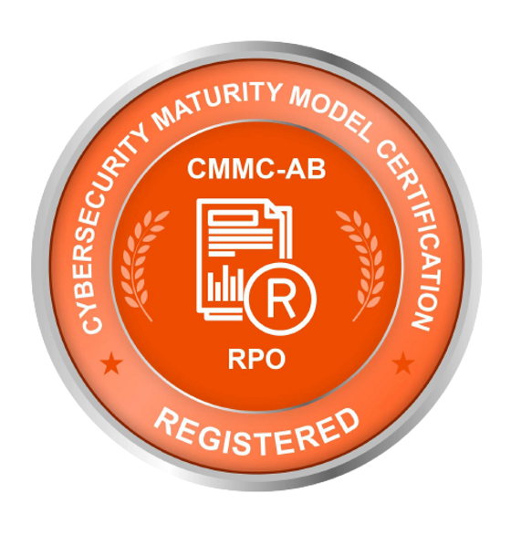
About us
At Volar Security, we understand that cybersecurity is not always easy. Since 2020, we’ve been helping companies of all sizes respond to cybersecurity and compliance challenges to stay competitive.
Our years of experience working with global enterprises and supporting federal and commercial customers have taught us how to implement world-class information security programs.
Our team of experts is ready to help you develop strategies for not only surviving but thriving in the future.
Give us a call today to set up your first consultation.

Slide 3
About us
Certifications and Information
DUNS: 117436232 | CAGE: 8MWC9
State of Florida certified Veteran and Minority Owned
VA Center for Verification and Evaluation
Service Disabled Veteran Owned Small Business (SDVOSB)
Florida Makes: Third Party Provider - Cybersecurity
CMMC-AB Registered Provider Organization

Slide 4
Our Services
IT and Cybersecurity Consulting
IT/ITSEC Program Design
Proposal Support
Government Contract Teaming
Managed IT Services
Computer and Network Equipment Procurement
Governance, Risk, & Compliance Consulting
vCISO Services
CMMC Enclave Design Consulting
MSP Support Services
Microsoft Cloud Migration Services

Slide 5
How can we help you?
David A. Africano
CISSP, CMMC-AB Registered Practitioner
David.Africano@volarsecurity.com
https://www.volarsecurity.com
Mobile: 321.266.7763

